Slide 1
An algorithmic approach to reducing unexplained pain disparities in underserved populations
Emma Pierson, David Cutler, Jure Leskovec, Sendhil Mullainathan, Ziad Obermeyer
Notes:
Start with overuse
Then under
Start with undertasnding of health care system. Drives which q to ask, which experiments to run. Common idea is overuse.
Pipeline: incentives. low average yie.d. drives payment schemes.
SO let’s look at the evidence again. ML suggests individual level stuff, risk prediction.
Not going to talk abuot decieion aids. Why/ understanding can drive

Slide 2
Pain is concentrated in society’s most disadvantaged
But story isn’t as simple as it looks
Typical exercise in literature, e.g., for knee osteoarthritis:
Two patients, similar x-rays
Compare pain scores
Black, lower-income, lower-education: still have more pain
At every level of x-ray graded disease severity

Slide 3
Some explanations from the literature
If it’s not in their knees…
Maybe it’s in their heads?
Stress makes similar stimuli more painful
Psychosomatic factors
Coping skills
Or in the medical system
Access to therapies

Slide 4
Concrete clinical scenario
Pain
Implication of literature
Black patients’ pain not reflected in disease severity
Leads to allocation of non knee-based treatments
But what do we mean by ‘disease severity’?
How do we measure it?
X-ray
Looks normal
‘Not in the knee’

Slide 5
Current SOTA

Slide 6
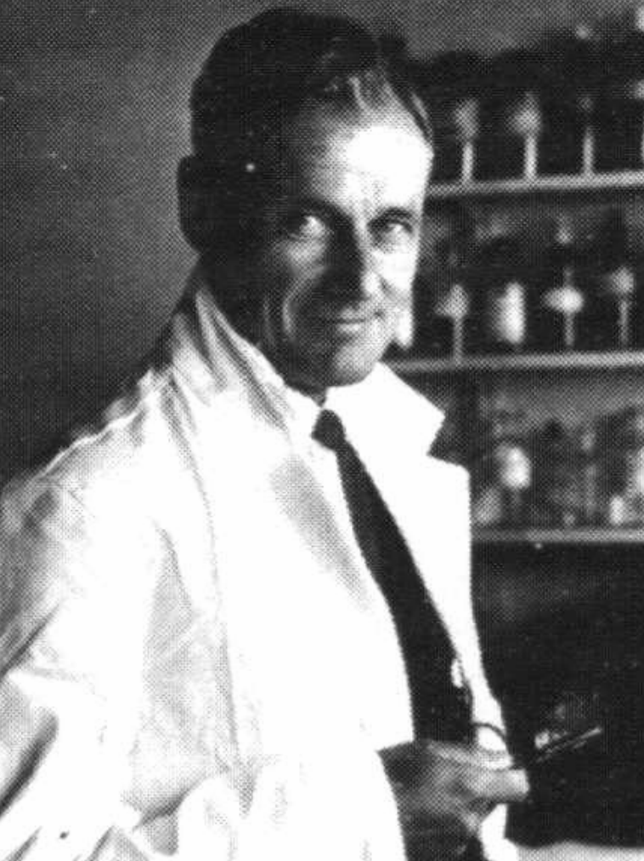
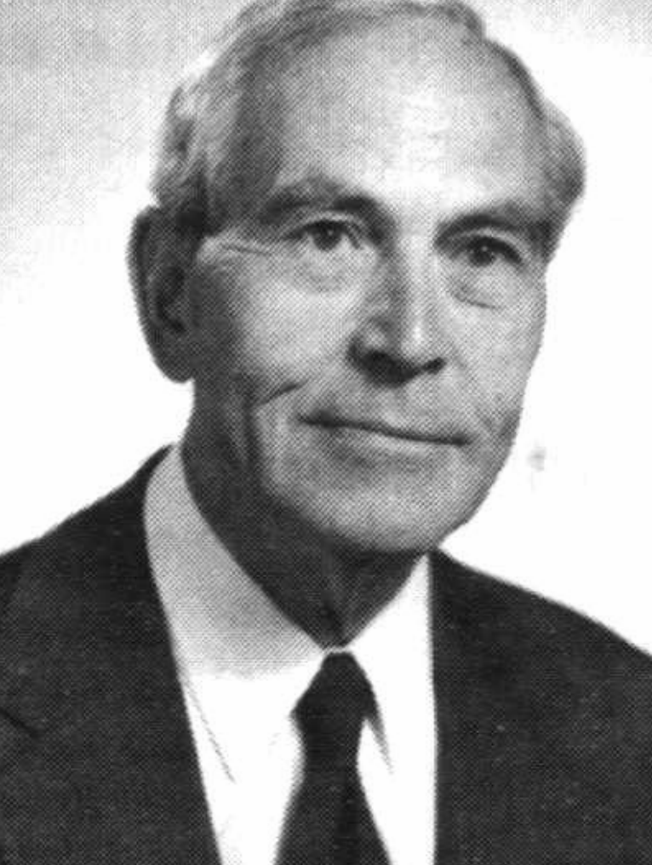
Measuring osteoarthritis severity
Objective grading scales, based on x-ray appearance
Most common: Kellgren-Lawrence, 1957 (KLG)
Original studies on coal miners in Lancashire, England
No mention of subjects’ race, sex
Notes:
http://research.bmh.manchester.ac.uk/musculoskeletal/aboutus/history/arc/jubilee.pdf

Slide 7
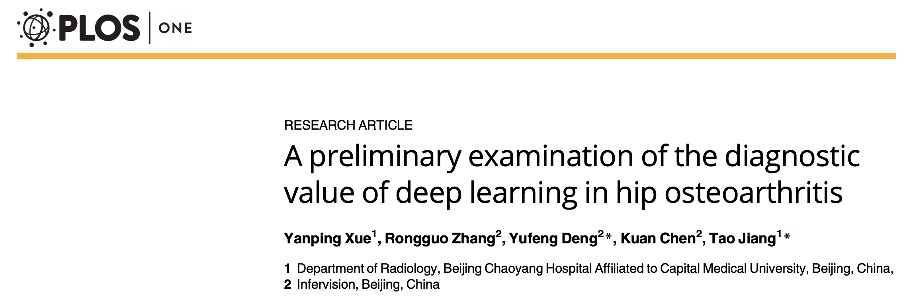
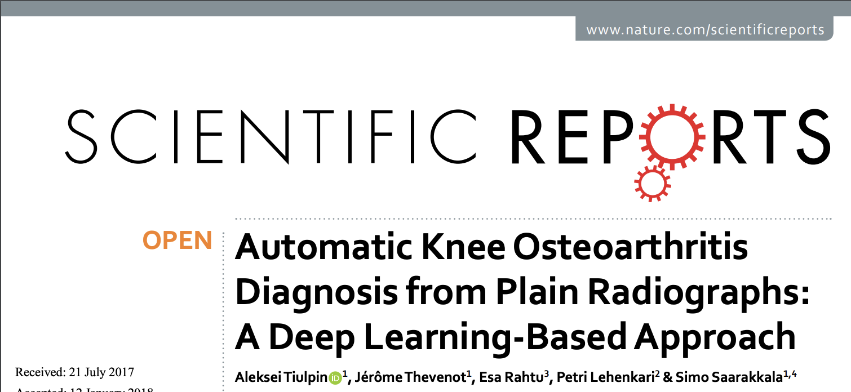
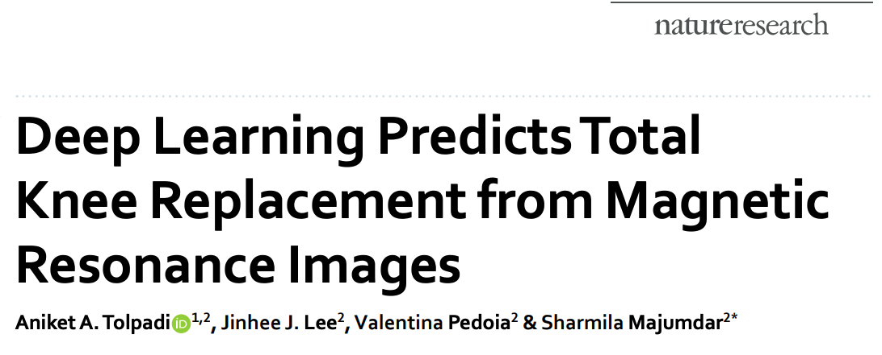
A good job for an algorithm?
Human radiologists may overlook causes of pain in disadvantaged groups
We’d like an algorithm to help—but…
Typical approach: train to match human performance
…Exactly what we don’t want to do!
If we’re worried about human bias
Notes:
https://www.nature.com/articles/s41598-018-20132-7.pdf?origin=ppub

Slide 8
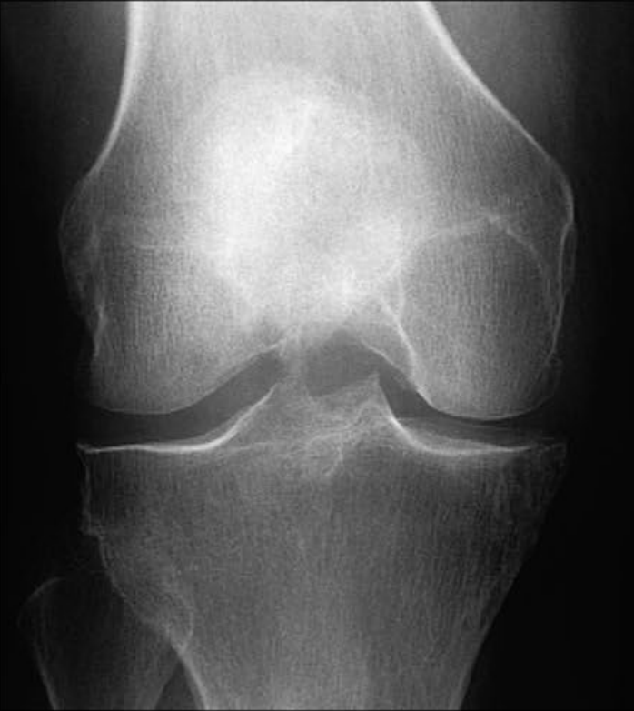
Finding a better target for prediction
Learn from the radiologist
Listen to the patient
Kellgren-Lawrence = 2/4
Pain = 9/10

Slide 9
Finding the data: Not straightforward
Easy to find: x-rays + radiologist interpretation
Sitting on every hospital’s PACS system
Much harder to find: x-rays + patient pain experience
But once we have data: a very straightforward ML problem
If pain is predictable from knee image
…Pain is in the knee (not in the head, coping, …)

Slide 10
Algorithm closes nearly half the pain gap
Adjusting for standard severity measure: –9%
Adjusting for algorithmic severity measure: –43%
4.7x more than standard measure
95% CI: 3.2-11.8
Similar results for
Income: 2.0x
Education: 3.6x
Koos score: Max 100, severe ≤86
Pierson, Cutler, Leskovec, Mullainathan, Obermeyer, Nature Medicine 2019

Slide 11
Couldn’t this just be…
Reconstructing race (or BMI, or other pain correlates)
No. We can control for these directly
Doesn’t change algorithm’s explanatory power for pain
Artifact
No. Robust across study sites
Better weighting of known features, or better binning
No. Radiologist features don’t explain all of prediction
And binning predictions doesn’t change anything

Slide 12
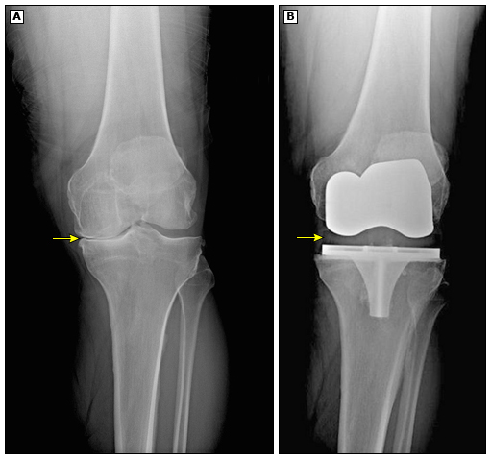
The stakes are high
Take patients with severe pain
Simulate swapping in algorithm severity, not radiologist
Doubles fraction of Black knees eligible for surgery

