Slide 1
Diagnosing Physician Error
A Machine Learning Approach to Low-Value Health
Sendhil Mullainathan
University of Chicago
Ziad Obermeyer
UC Berkeley
Notes:
Start with overuse
Then under
Start with undertasnding of health care system. Drives which q to ask, which experiments to run. Common idea is overuse.
Pipeline: incentives. low average yie.d. drives payment schemes.
SO let’s look at the evidence again. ML suggests individual level stuff, risk prediction.
Not going to talk abuot decieion aids. Why/ understanding can drive

Slide 2







A dilemma for ER doctors :
Is this a heart attack?
…
Test for blockage?
Chest pain
Dyspnea
Nausea
…
A hard problem
Stress test
Catheterization
vs.
Missed heart attack
Wasted resources
Notes:
Surprising thing about becoming a doctor is how many tough decisions
Talk about one: these symptoms can be someone having a heart attack right in front of me
Not very good at knowing based on easy tests, talking, exam. So keep and test? Or send home?
Feels hard; but also evidence that doctors struggle. How?

Slide 3
Our model of testing
Patients have blockage with probability b(X,Z)
  If tested: blockage gets treated, huge health benefits
  If untested: missed blockage, adverse events increase
Socially optimal testing rule: Test iff b(X,Z) > Threshold
  Reflects fact that only positive tests have (net) benefits
  Negative tests have only costs
Physician testing rule: Test iff h(X,Z) > Threshold – Incentive
  May mis-predict risk: h(X,Z) ≠ b(X,Z)
  May have private incentive to test

Slide 4
Our empirical tests
Any set of patients defined by (X,Z) is either above or below threshold for optimal testing
Over-tested: Any set of tested patients with yield below a threshold, based on cost-effectiveness of tests/treatments
  Eliminating all tests in this set increases welfare
Under-tested: Any set of untested patients with adverse event rates above a threshold, based on clinical guidelines
  Testing everyone in this set increases welfare
Note: Incentives → over-testing only; Misprediction → both

Slide 5
The role of machine learning
Form explicit predictions on blockage risk using ML
  Find subgroups with potential errors, based on X
But algorithm ≠ arbiter of truth: We don’t assume it’s right
  Physician has information advantage, based on Z
  Many signals for risk, treatment benefit unobserved
So actual errors are identified using health outcomes
  Observed testing yield and adverse events
  Not imputed outcomes

Slide 6
Prediction setup
Features
Outcomes
t₀: ER visit
Over 2 years before visits, construct candidate features
  k = 16,381
Over 10 days after visits, observe
Tests, Treatment
n = 246,265 ER visits (129,859 patients), 2012-15
  Remove: ≥80yo, serious illness, nursing home, etc.
Train ensemble (xgb+lasso) in a 3/4 random sample
  Predict yield, E[Y|X,T=1], as proxy for blockage B
  Show results from 1/4 hold-out set only

Slide 7
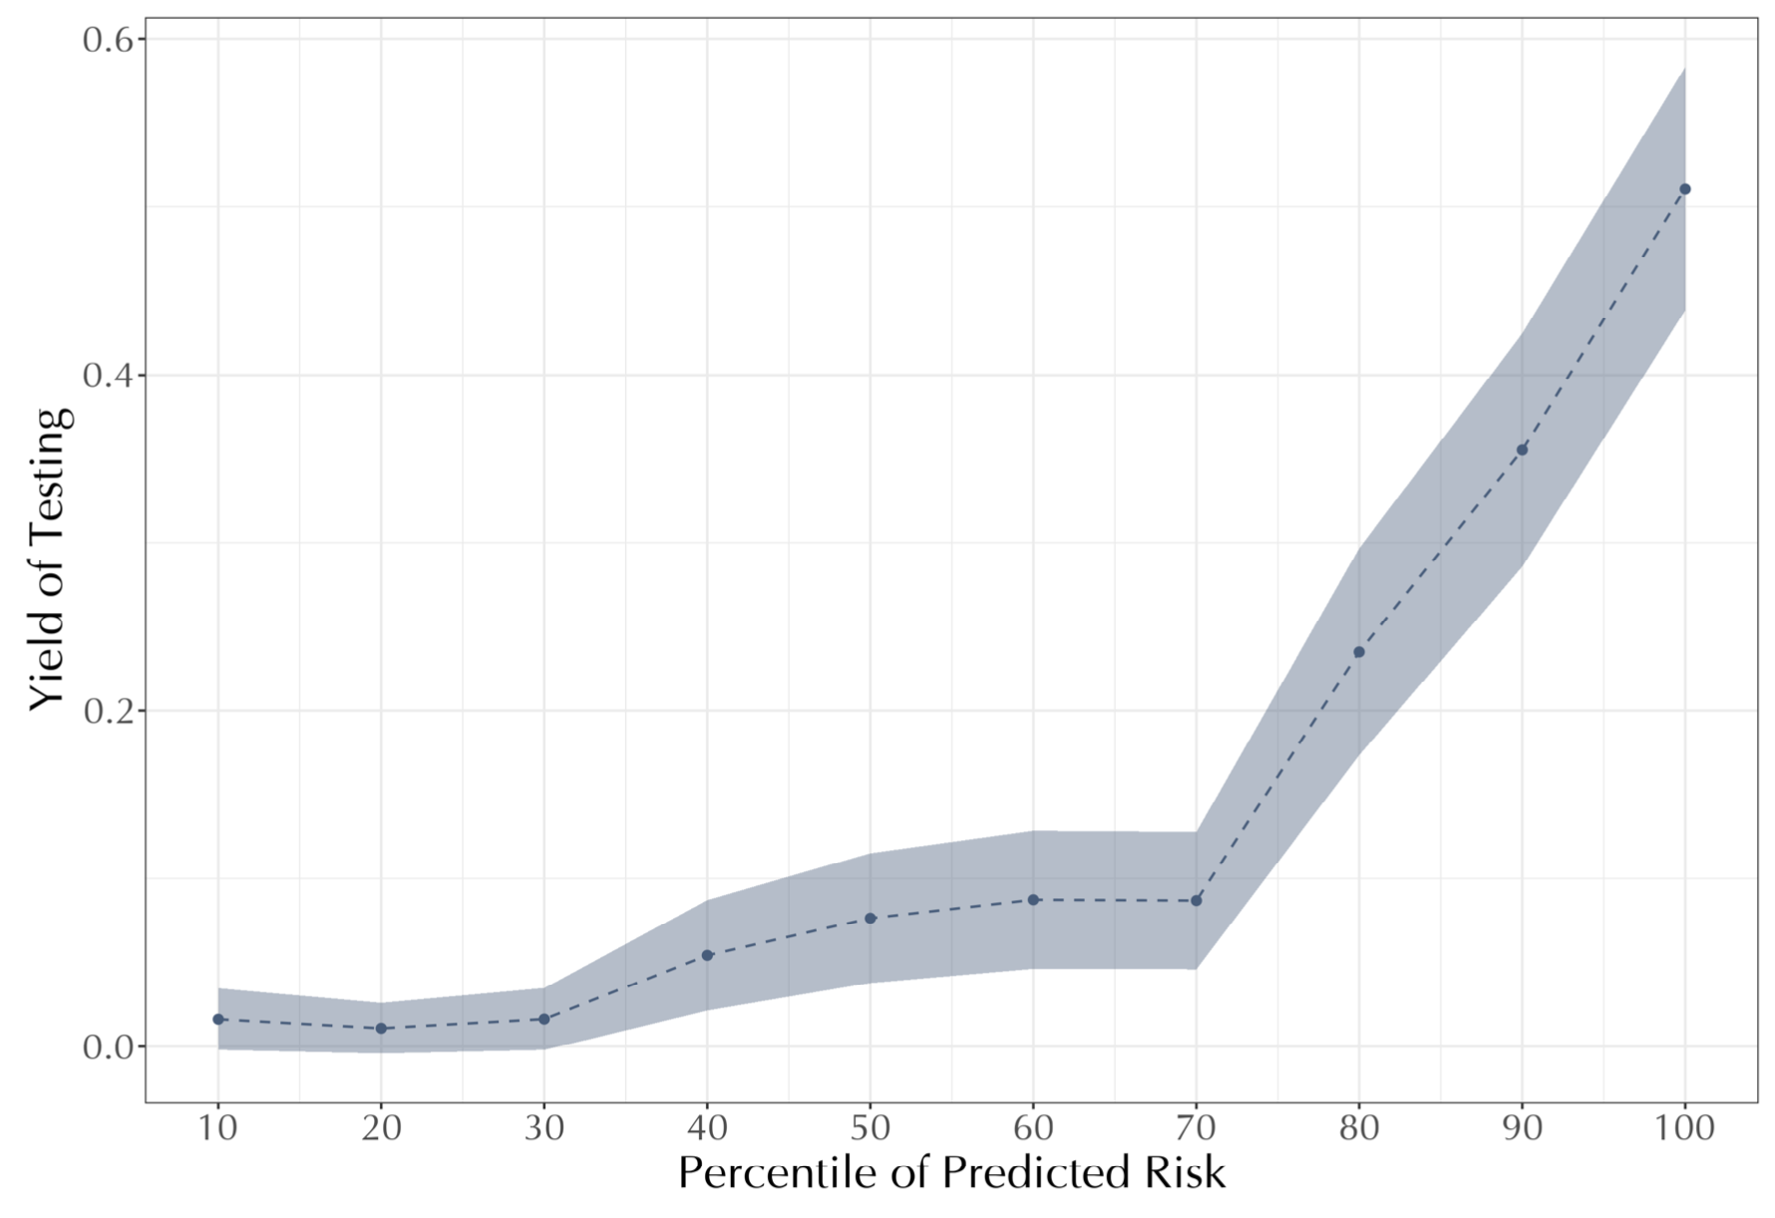
  Tested patients: Predictable variation in yield
Top bin: 52.0% yield
($46,017/life year)
Seems high value …But only 55% tested
Under-testing?
Lowest bin: 1.6% yield
($1.35 million/life year)
Over-testing
Average: 14.3%
($89,714/life-year)

Slide 8
Selection into testing means we can’t conclude under-testing
Yes, physicians fail to test apparently high-risk patients
  Replicates result of Abaluck et al. 2016
  But physicians may leave untested for good reason
    Symptoms, exam, ECG, labs, …
In the tested: We looked at test result to see who’s right
  In the untested: No test results!
Solution 1: Compare adverse events in untested eligibles to clinical thresholds from decision rules
Solution 2: Exploit a quasi-experiment that shifts testing rate, to measure impact of testing on health

Slide 9
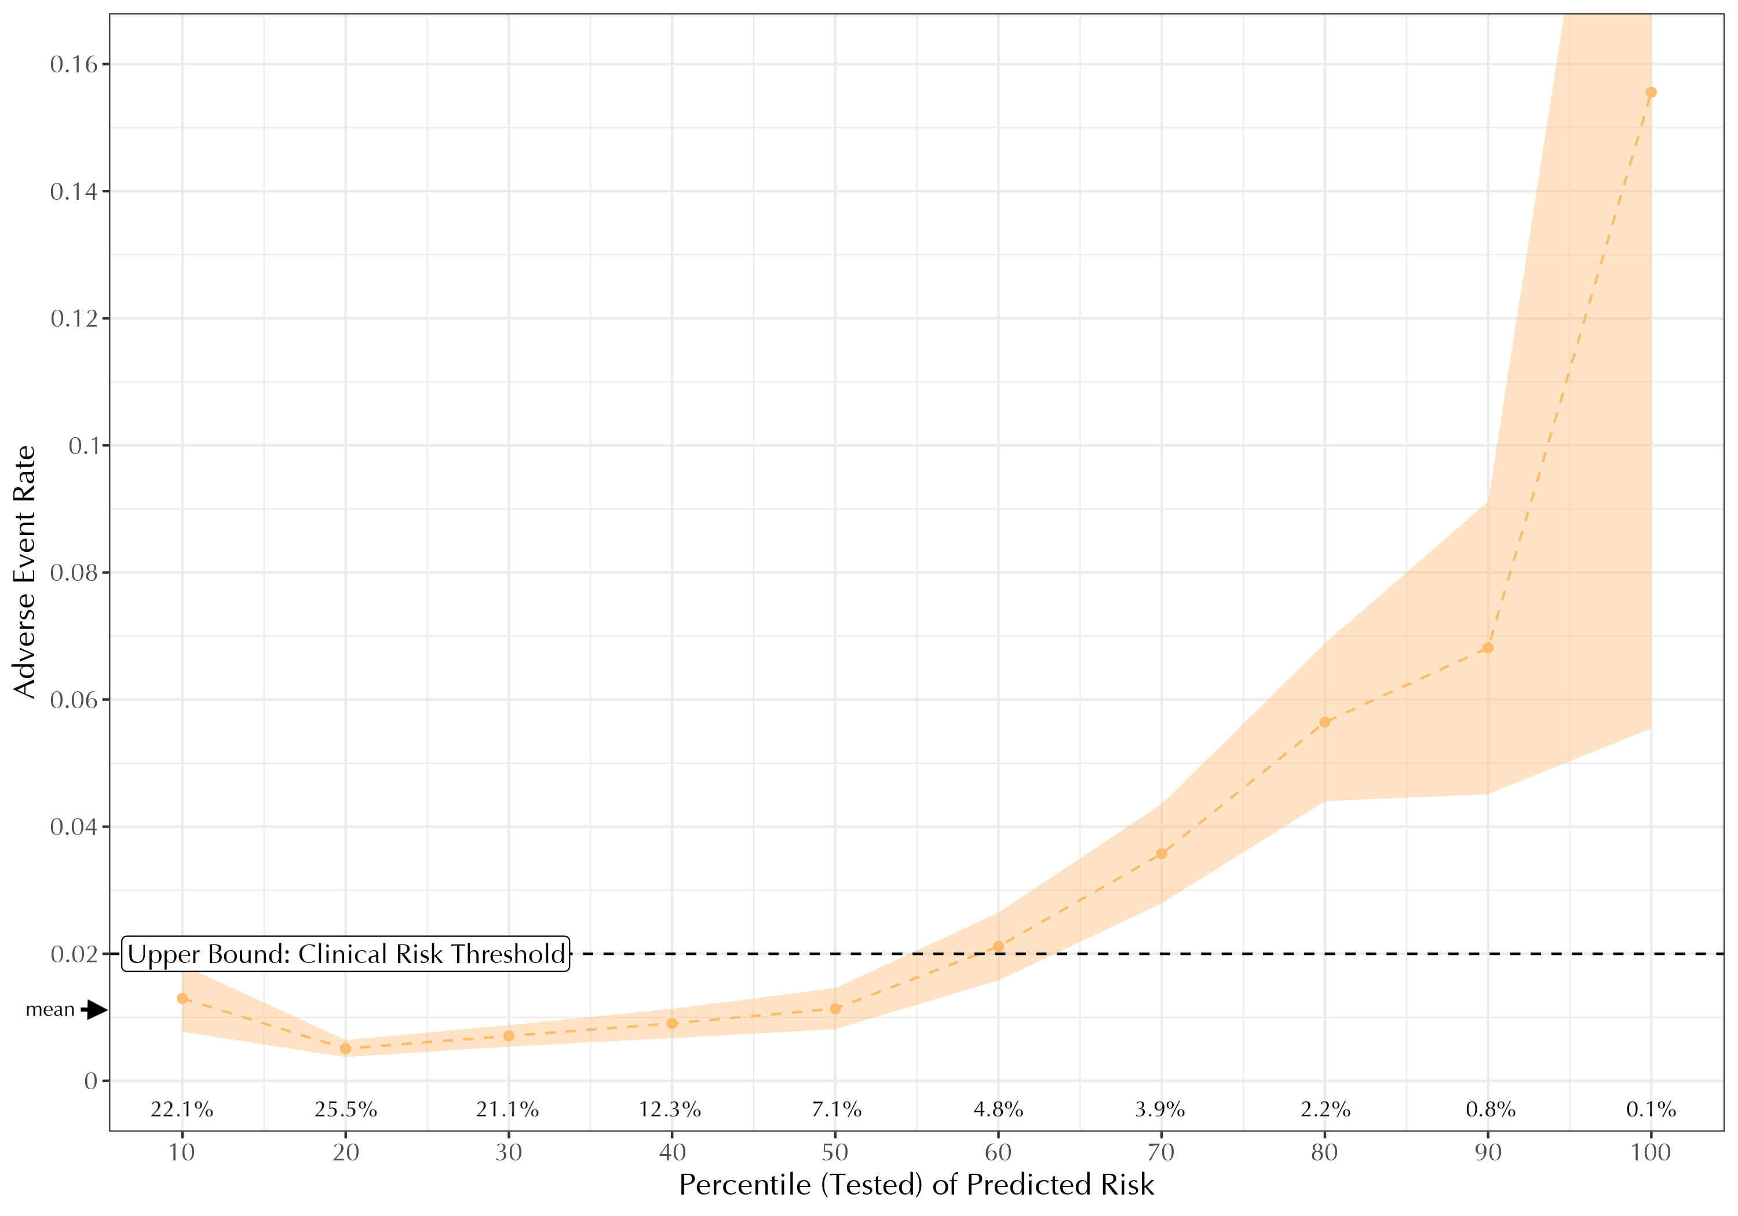
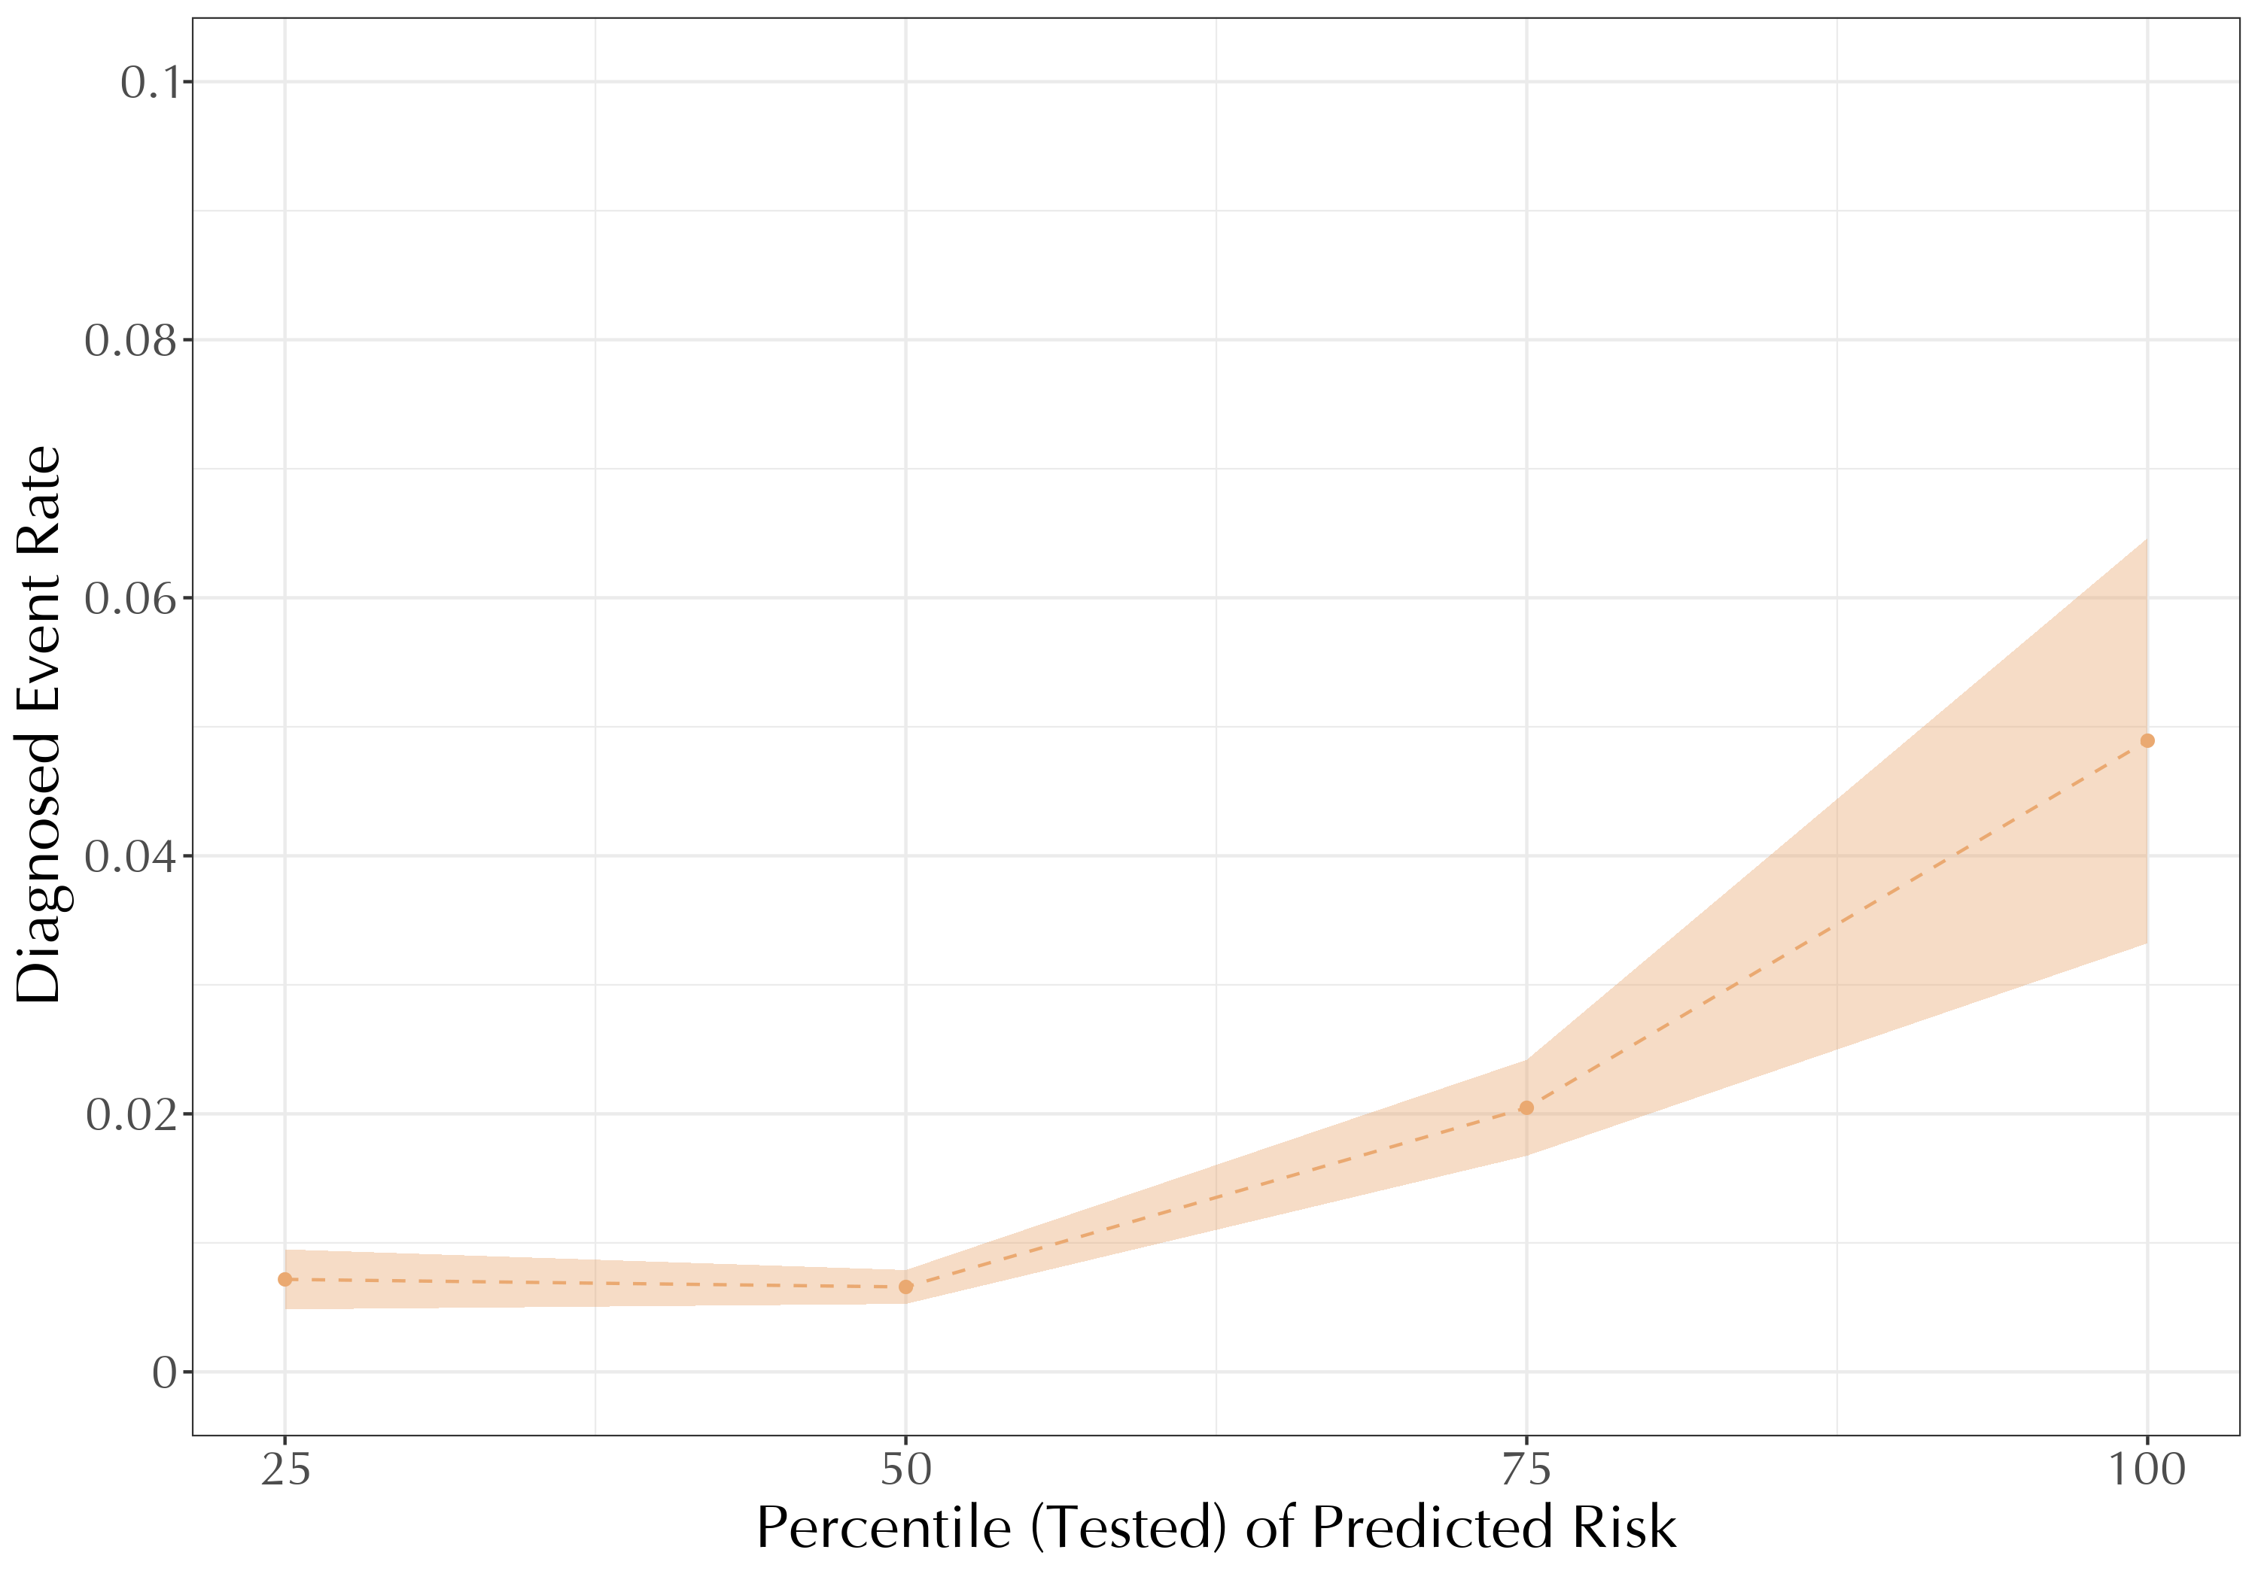
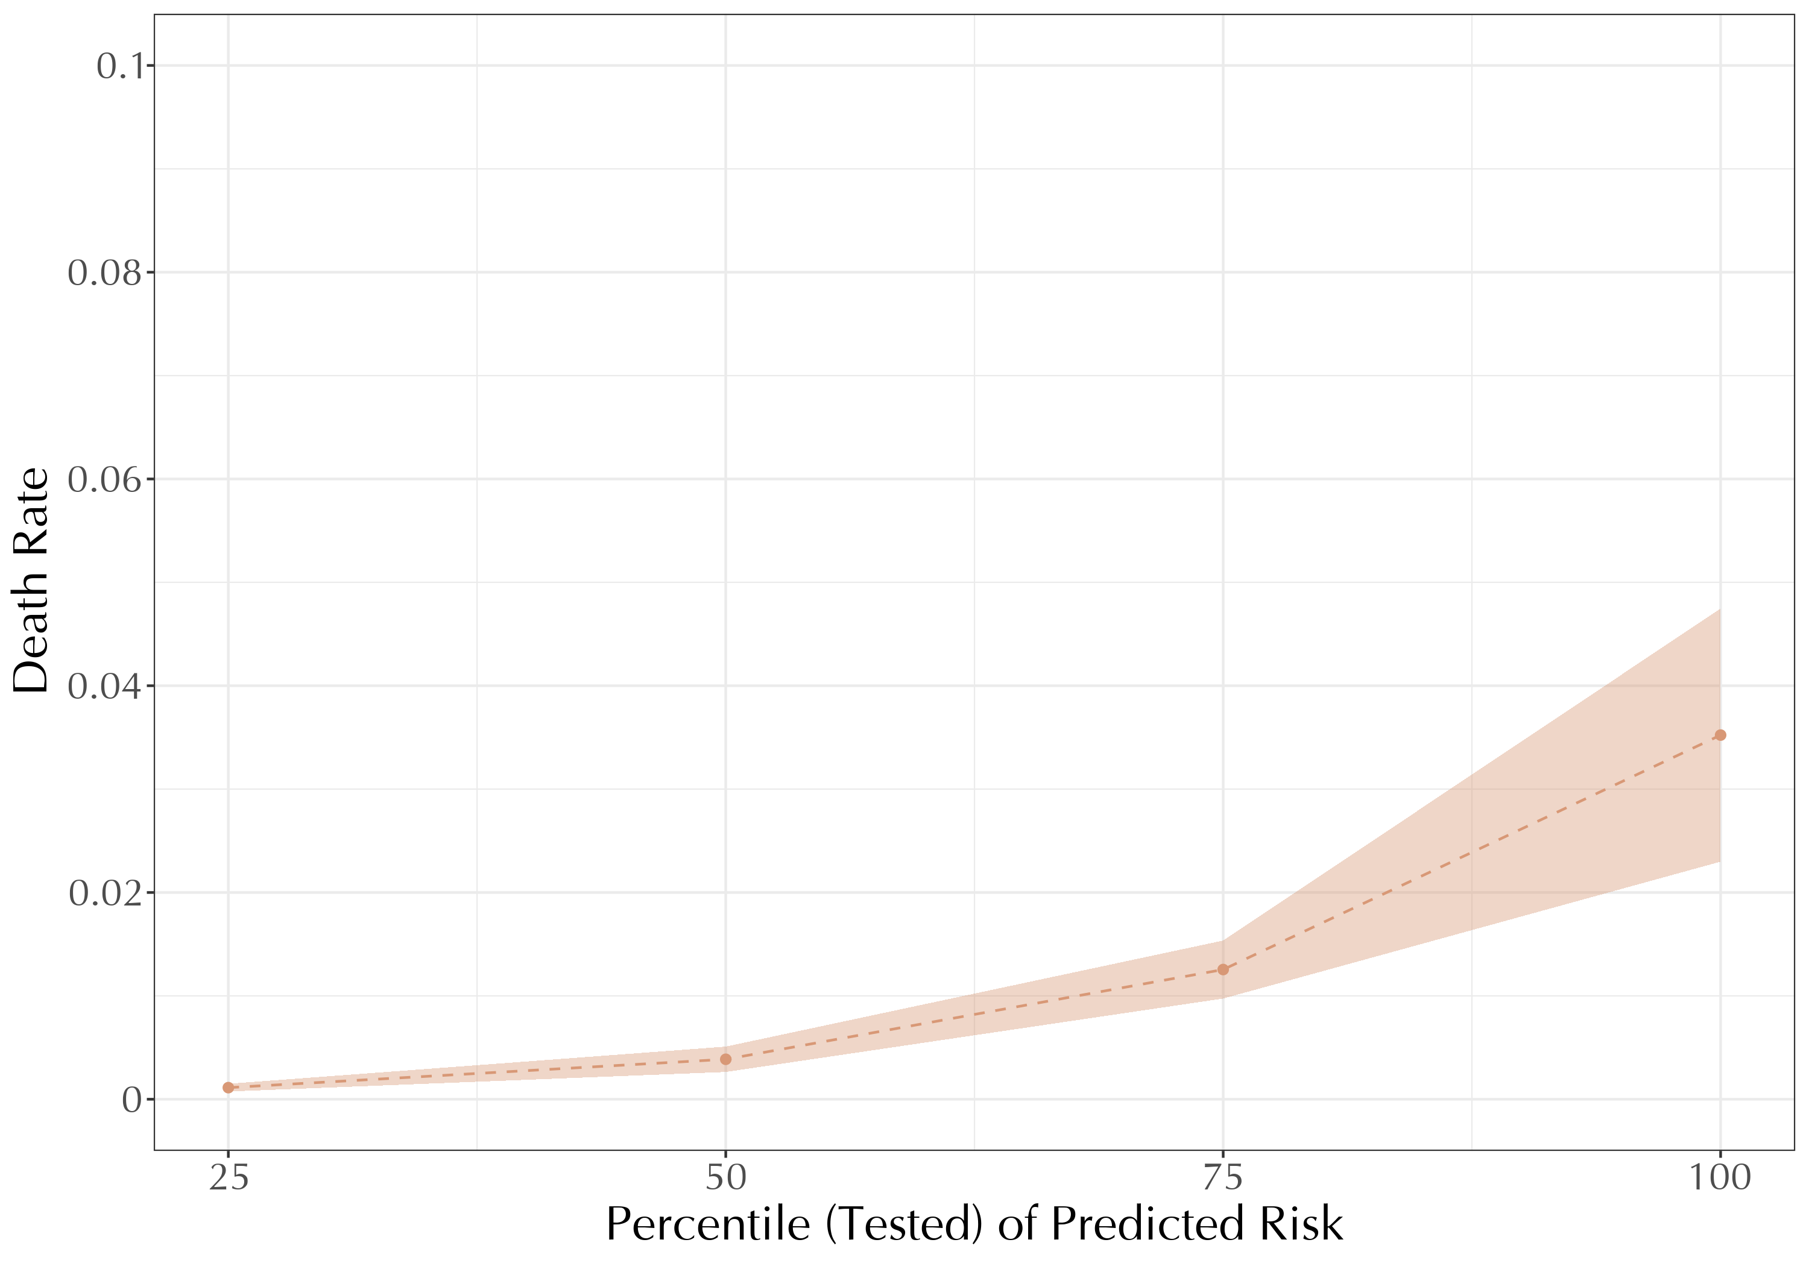
1a. Untested patients: Short-term adverse events
*excluded: usual suspects (frail), those with diagnosed heart problem in ER
Total Adverse Event Rate
Components
Adverse cardiac event
Diagnosed heart attack or treatment
  Confirmed with labs
Cardiac arrest
+ Death
15.6% at 30 days
Adverse cardiac events
+
Death
5.6%
2% clinical threshold

Slide 10
Would these patients benefit from treatment?
Adverse events show high-risk people are truly high risk
  Physicians may be aware of this risk
  But decide not to test because of limited benefit
    e.g., in the frail we haven’t managed to exclude
Insight: Low-cost screening tests proxy for suspicion
  ECG, troponin done on everyone—even very low risk
  And even those with low treatment benefit
Adverse event rate in unsuspected patients: Lower bound
  Here, physicians are unaware of heart attack risk
  So failure to test can’t reflect private information

Slide 11
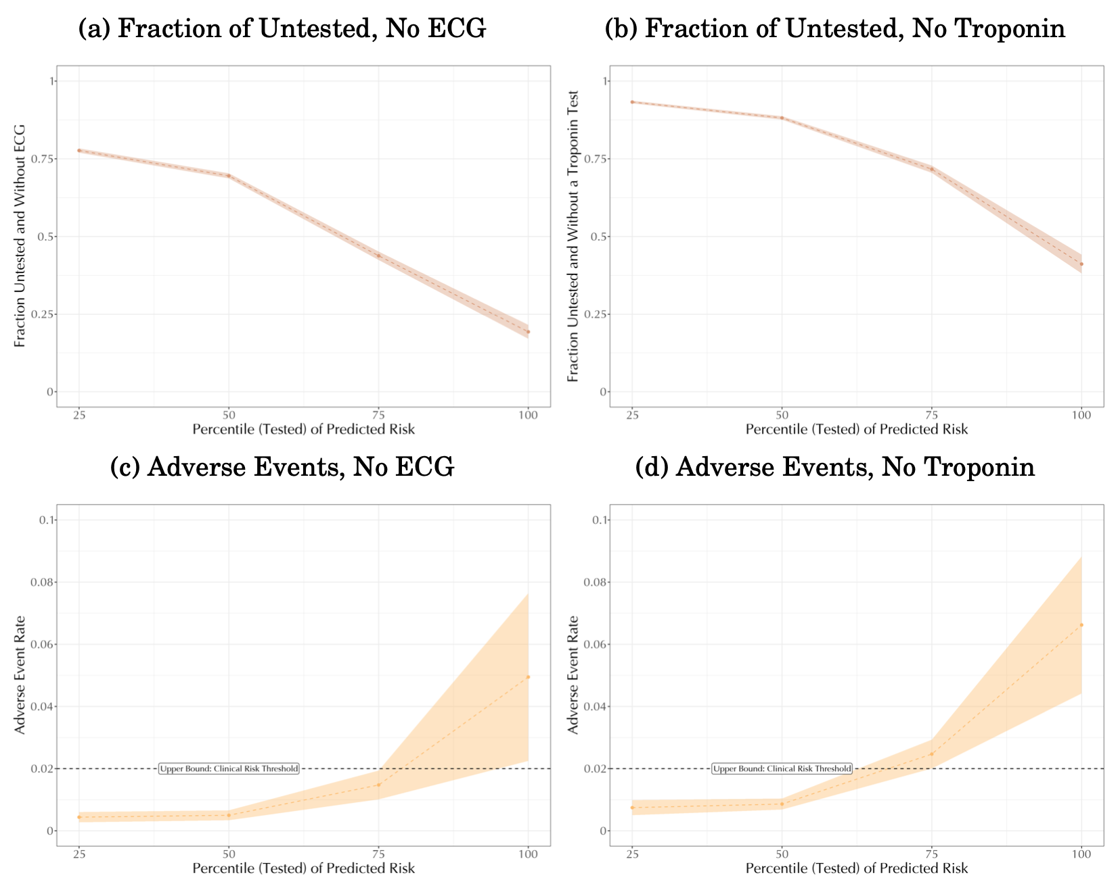
1b. Untested, unsuspected patients: Short-term adverse events
41% lack troponin
19% lack ECG
4.9% have adverse event
6.6% have adverse event

Slide 12
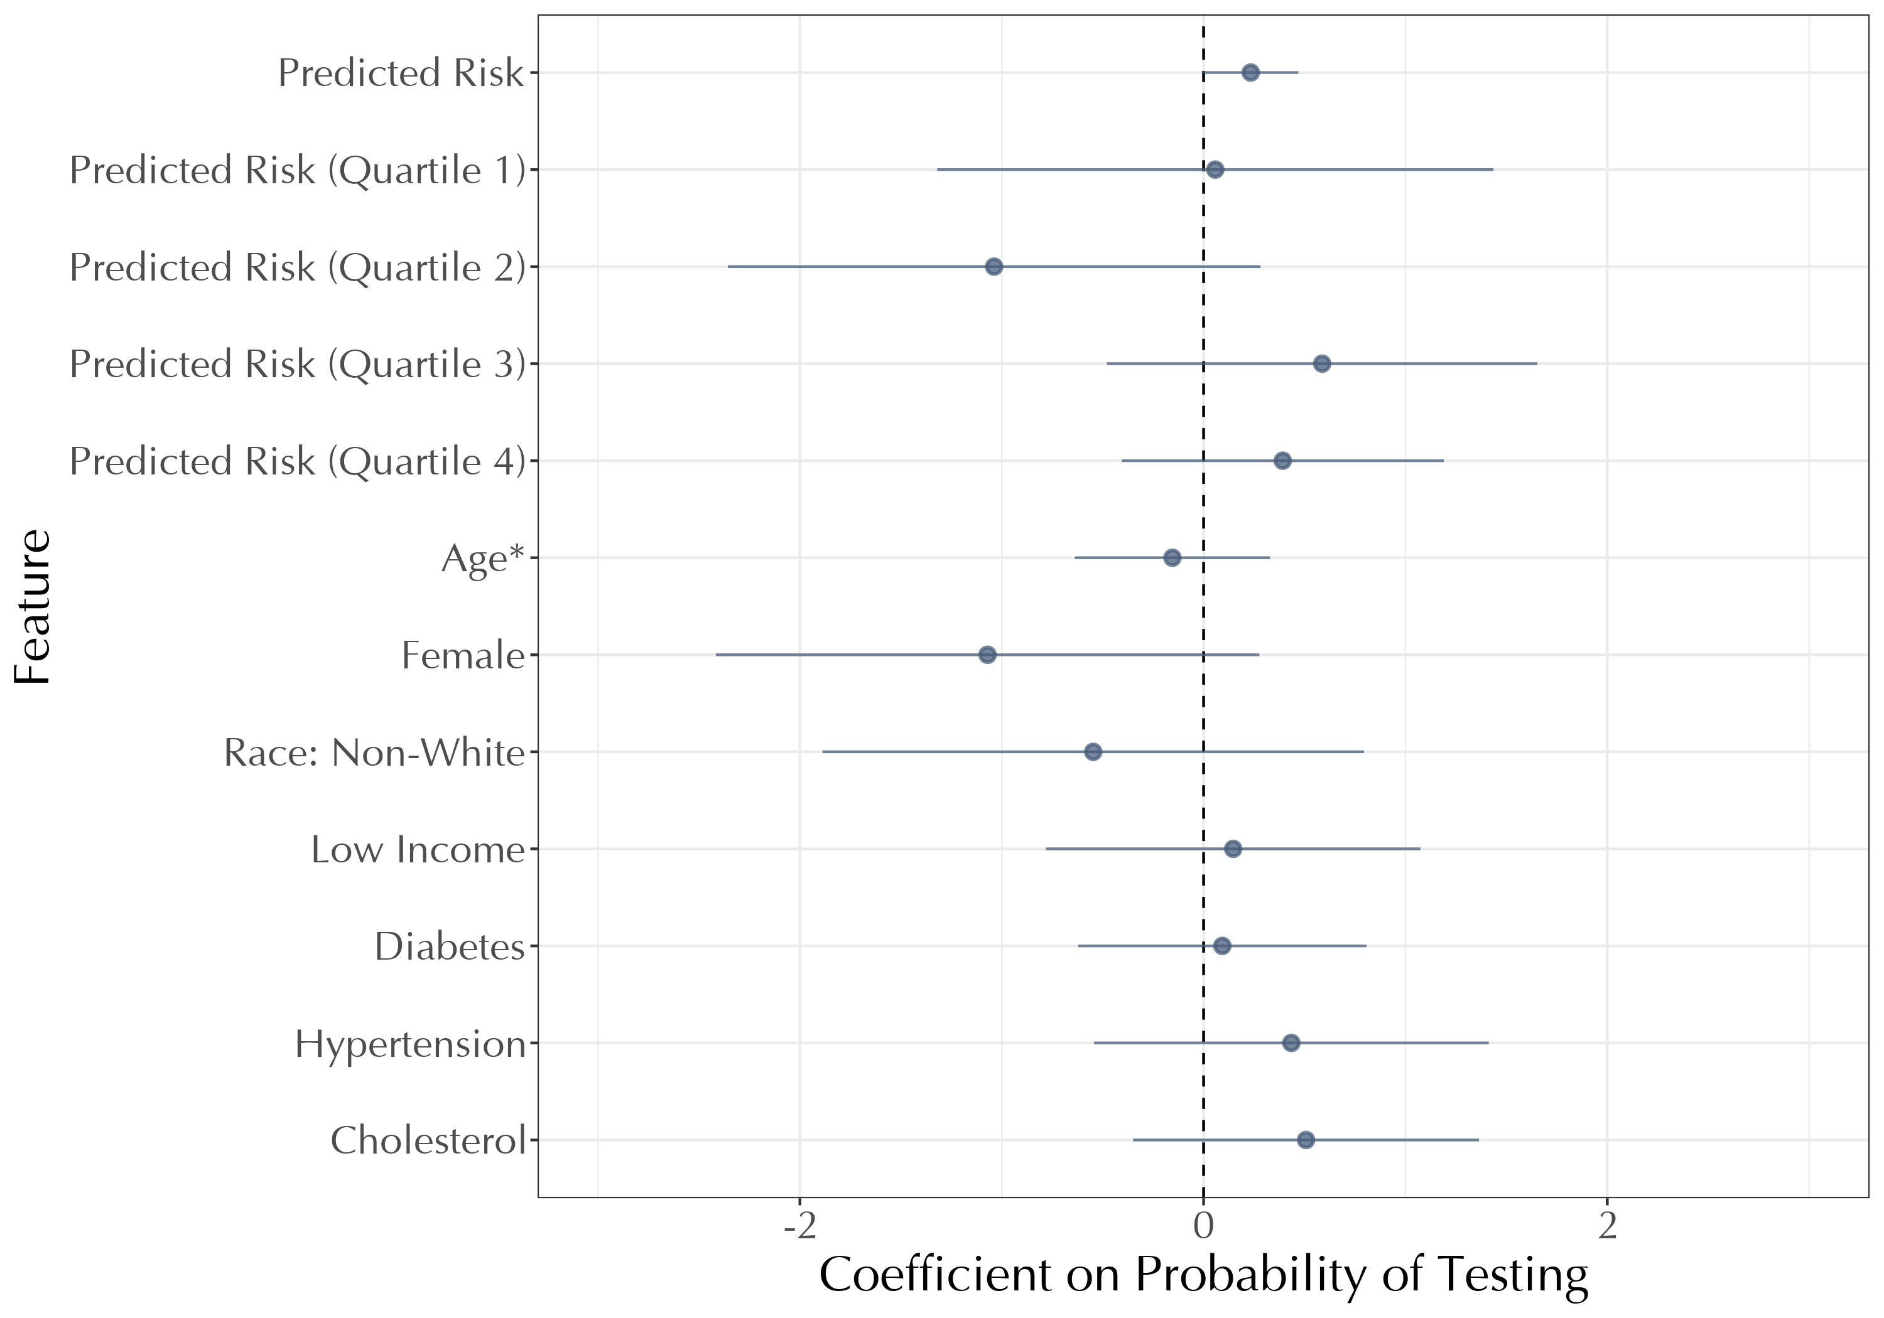
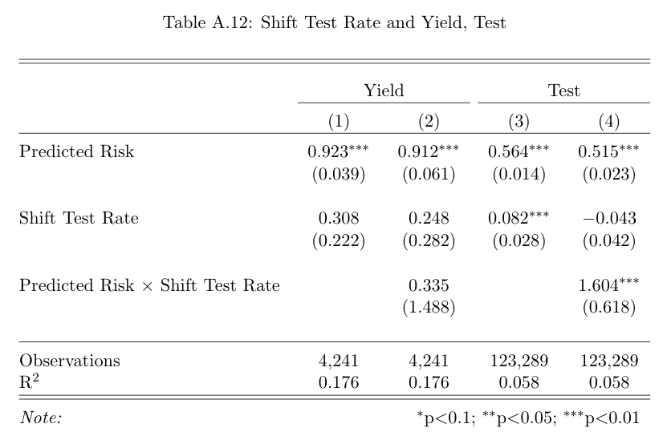
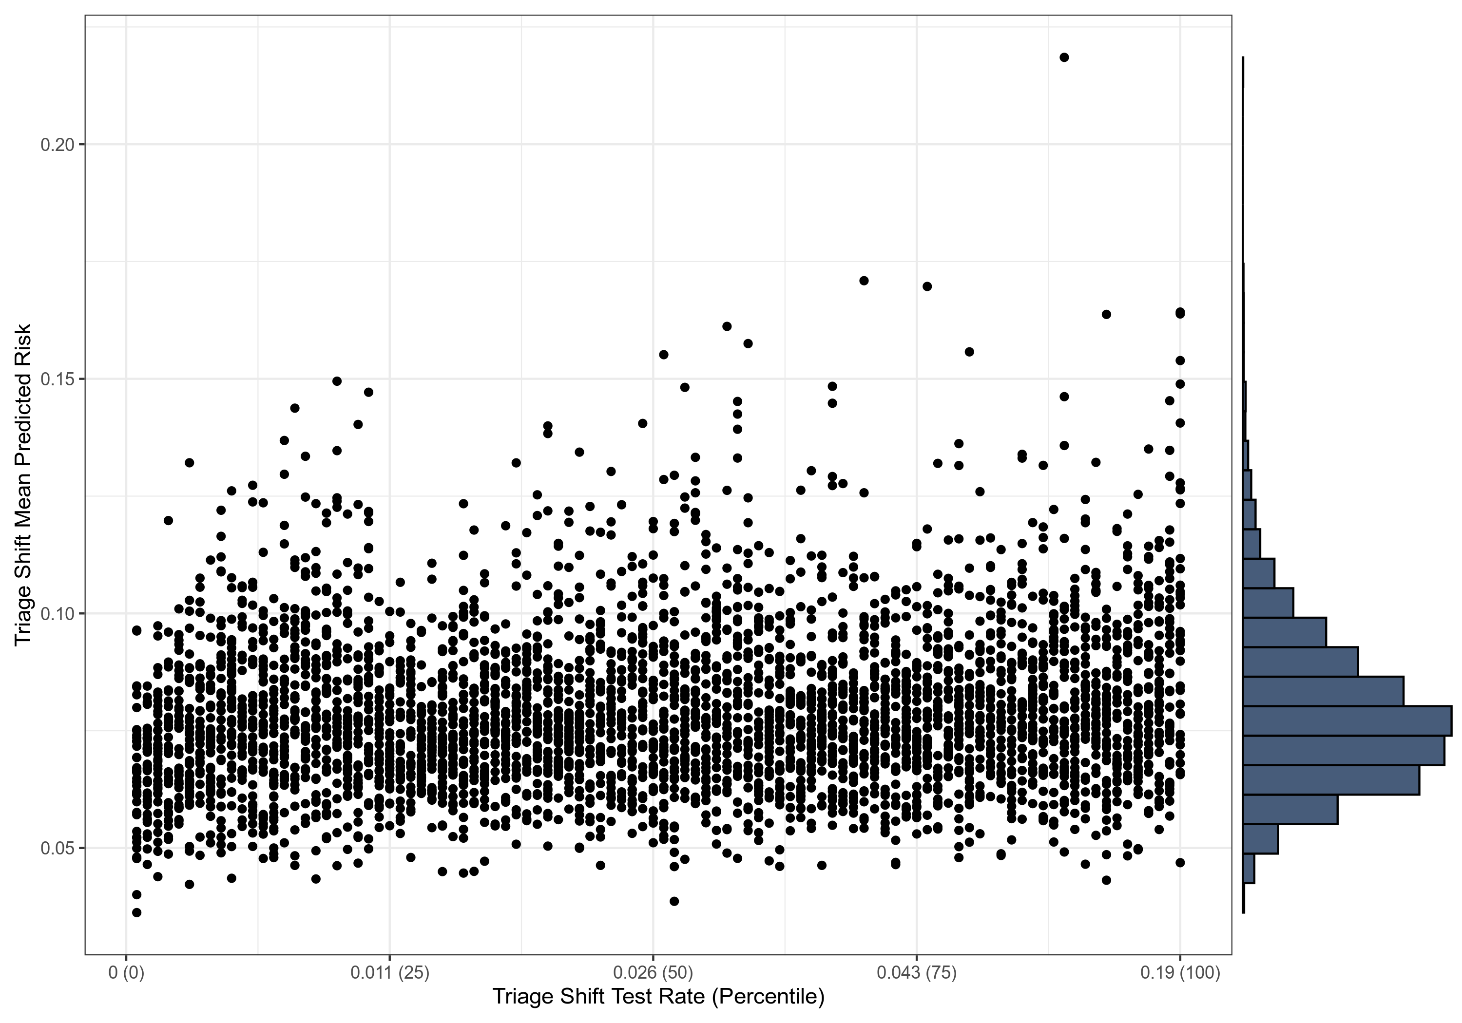
2. Quasi-experiment that moves testing rate
Ideal: Randomly test high-risk, measure health improvement
In our setting: ER triage teams test at different rates
  Observables (largely) balanced across shifts
  Yield conditional on predicted risk does not vary by shift
    Suggests balanced unobservables
  Large variation in shift riskiness at any given test rate

Slide 13
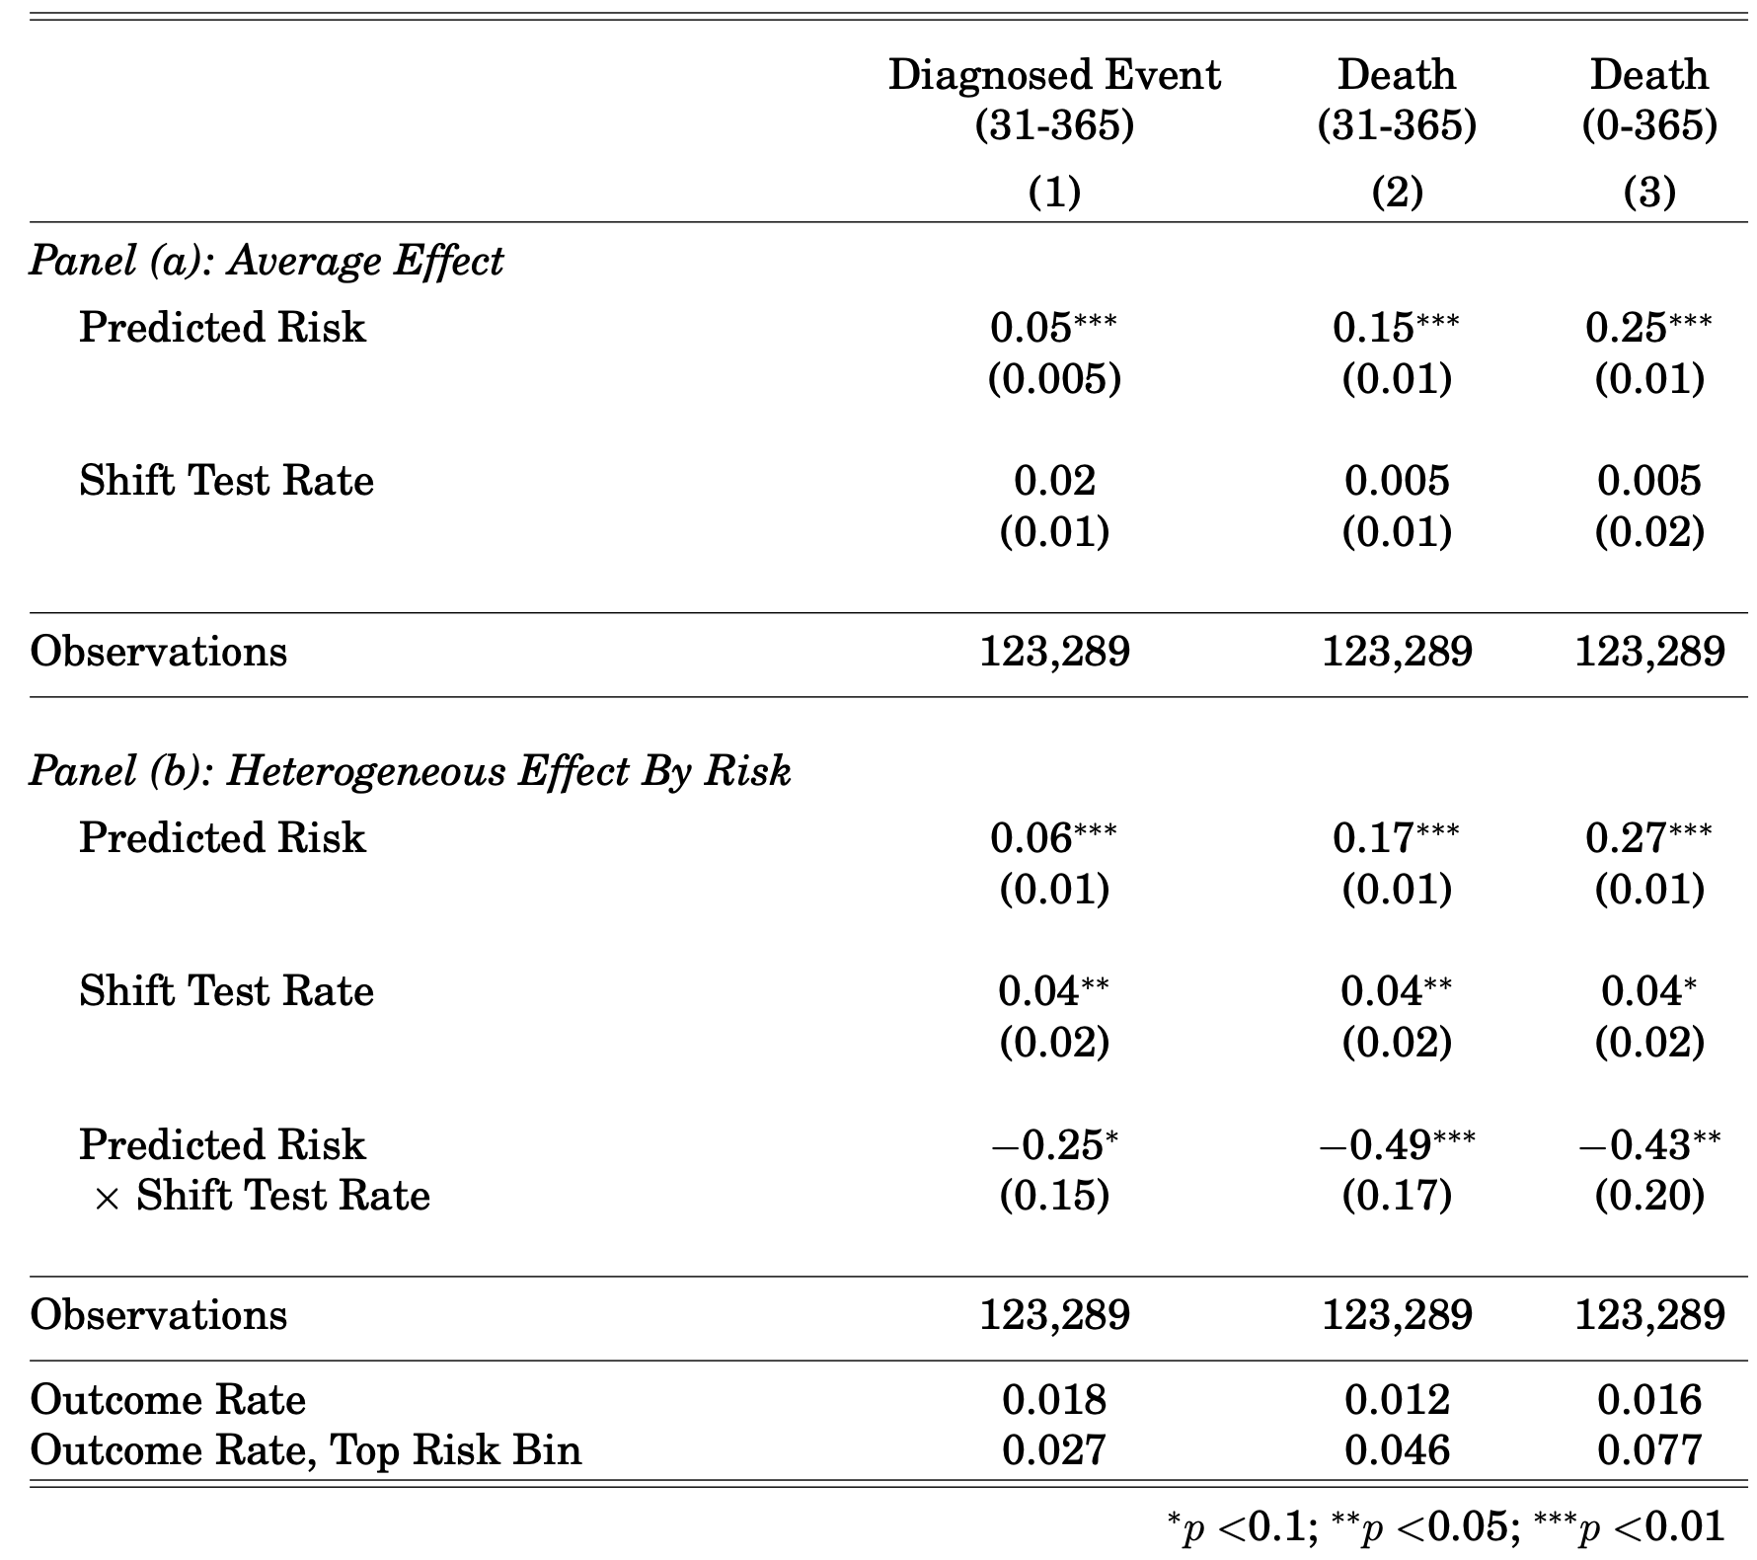
2: Quasi-experiment that moves testing rate
No effect of testing on average
‘Flat of the curve’ health care
Large effect in high-risk only
Move to high-test: 2.5 p.p. (32%) lower mortality
Notes:
Death: 0.016 overall, 0.077 top risk bin.

Slide 14
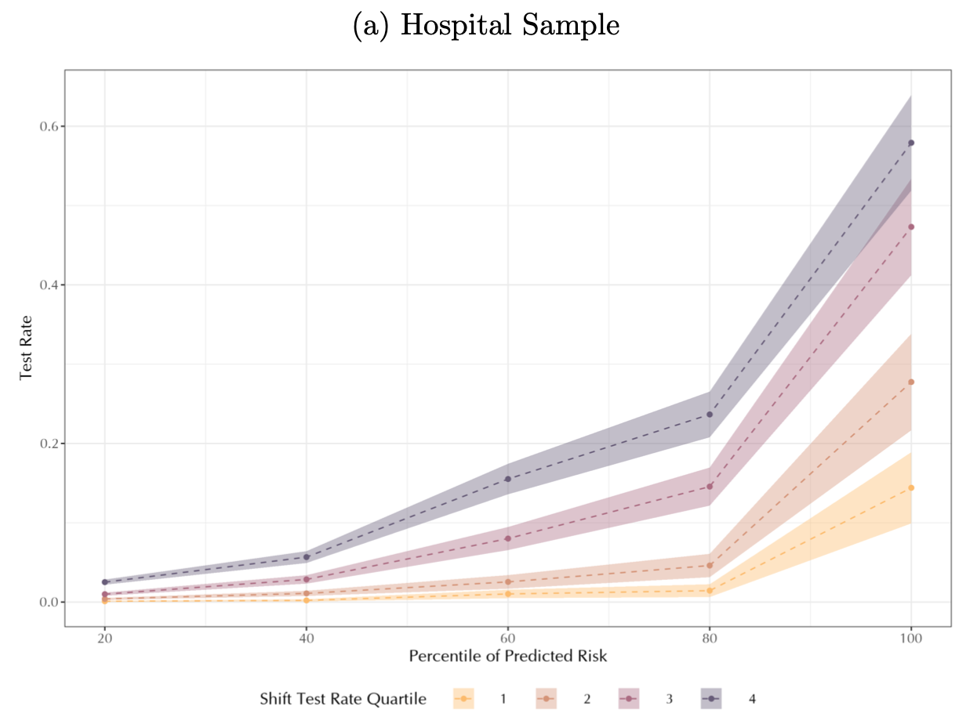
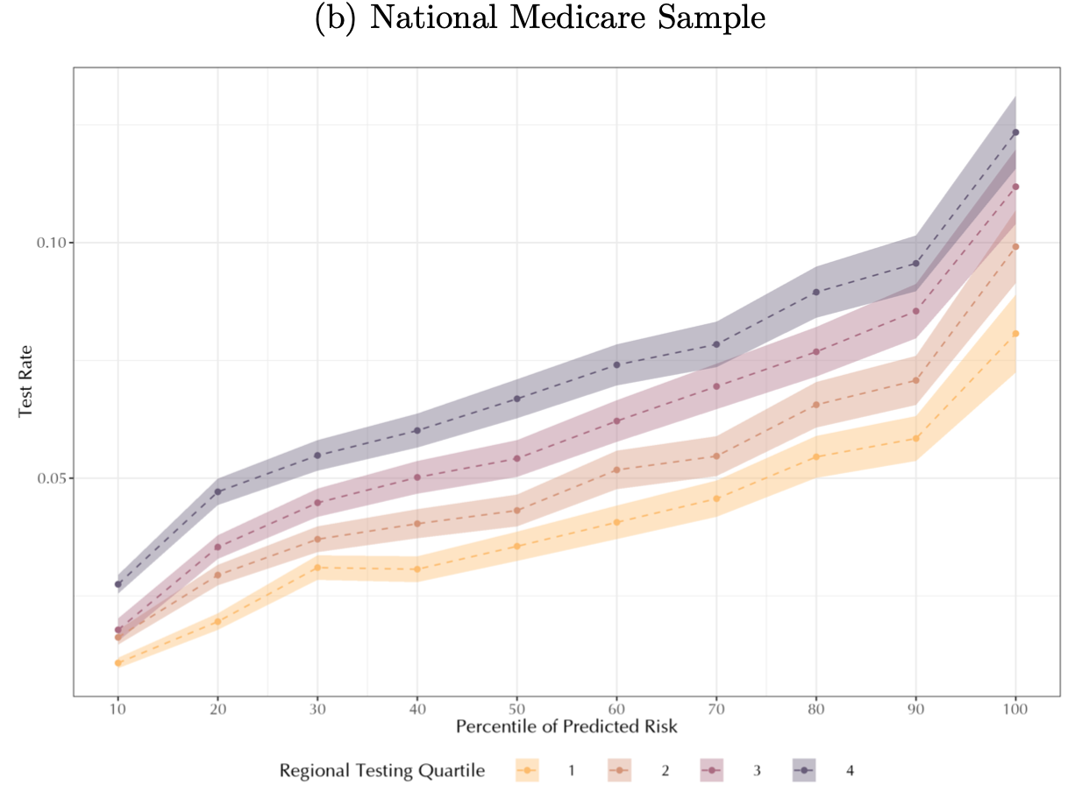
Policy implication: Incentives can backfire
High-testing
triage shifts
High-testing
hospitals
Low-testing
triage shifts
Low-testing
hospitals
Low-testing physicians cut wasteful tests
  And also valuable tests
Low-testing hospitals cut wasteful tests
  And also valuable tests

Slide 15
Today
An example of coexisting over- and under-use
  Testing for heart attack (ACS) in the ER
The root of this problem: Physician error
  ‘Bounded’ rationality
  Systematic biases

Slide 16
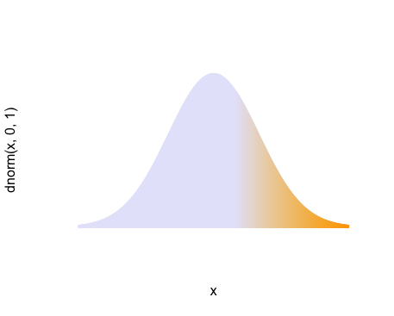
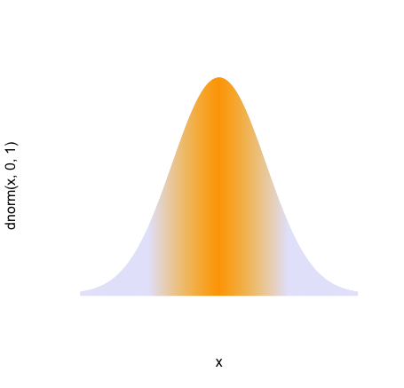
Two behavioral models of the physician
break even
1. Moral hazard
Test over a threshold
test
test
  Threshold too low
Low average yield
2. Mis-prediction
test
test
Test high and low risk
  At any threshold
Low average yield
Mis-prediction: Untested high-risk patients
Notes:
What does medicine say? Stress or cath.
What does health policy teach us? Overuse.
---
Why do we think that?
Low average yield
---
then back: but maybe there’s underuse; just a possibility
circumstantial
Same thing ,ex ante
Would still see low average yield;
---
then in this paper, we have an empirical framework to look at both
#################
library(RColorBrewer)
#plot.new()
# moral hazard
cnl<-"lavender"
chi<-"orange1"
startat<-.75
x <- seq(from=-3, to=3,by=0.01)
gb_gradient <-colorRampPalette(c(cnl, chi))
curve(dnorm(x,0,1), xlim=c(-3,3), lwd=.1, axes=FALSE)
segments(x, rep(0,length(x1)),x,dnorm(x,0,1) , col=cnl, lwd=2)
x <- seq(from=startat, to=3,by=0.01)
cols <- gb_gradient (length(x))
segments(x, rep(0,length(x)),x,dnorm(x,0,1) , col=cols, lwd=2)
#plot.new()
# misprediction
cnl<-"lavender"
chi<-"orange1"
startat<--1.5
endat<-1.5
x <- seq(from=-3, to=3,by=0.01)
curve(dnorm(x,0,1), xlim=c(-3,3), lwd=.1, axes=FALSE)
segments(x, rep(0,length(x1)),x,dnorm(x,0,1) , col=cnl, lwd=2)
x <- seq(from=startat, to=endat,by=0.01)
gb_gradient <-colorRampPalette(c(cnl, chi, cnl))
cols <- gb_gradient (length(x))
segments(x, rep(0,length(x)),x,dnorm(x,0,1) , col=cols, lwd=2)

Slide 17
The nature of physician mis-prediction
We examine how testing decisions deviate from risk
  Clinical judgment vs. statistical models
Specific tests of two hypotheses
  Bounded rationality
    Physicians use too simple a model of risk
  Systematic errors and biases
    Physicians mis-weight specific variables

Slide 18
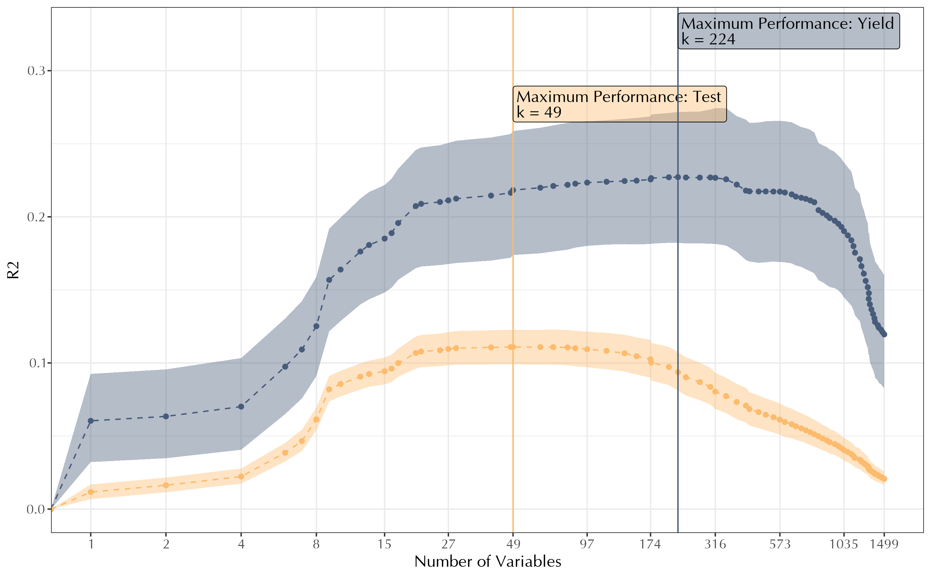
Physicians appear boundedly rational
Estimate best-fit risk models of varying complexity
  Lasso complexity measure: number of non-zero variables
How well do these predict
  True risk
  Test decisions
Best risk model:
k = 224
Best risk model far more complex than best test model
Best test model:
k = 49
Complexity (Number of non-zero variables, Lasso)

Slide 19
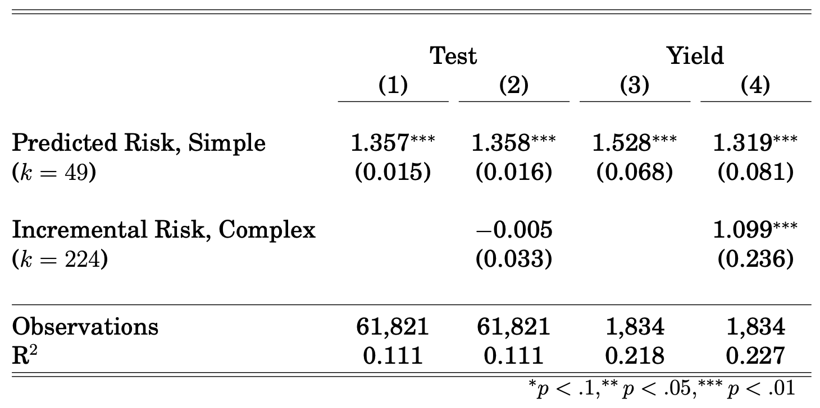
Turning this into a statistical test
Regress yield, test on ‘simple risk’ and ‘complex risk’
  Complex risk predicts yield, over and above simple risk
  But no added value for predicting testing

Slide 20
Some interesting implications of this
Humans seem to regularize (Camerer 2019)
  Make (pretty) good use of a small set of variables
A different conclusion from Dawes, Faust, & Meehl (1989)
  Where people use too complex a model
  And a statistical model does better by being simpler
Here we find physicians use too simple a model
  A statistical model does better by being more complex
  Maybe because phenomenon being modeled is complex
    The ‘illusion of sparsity’ (Giannone et al. 2021)

Slide 21
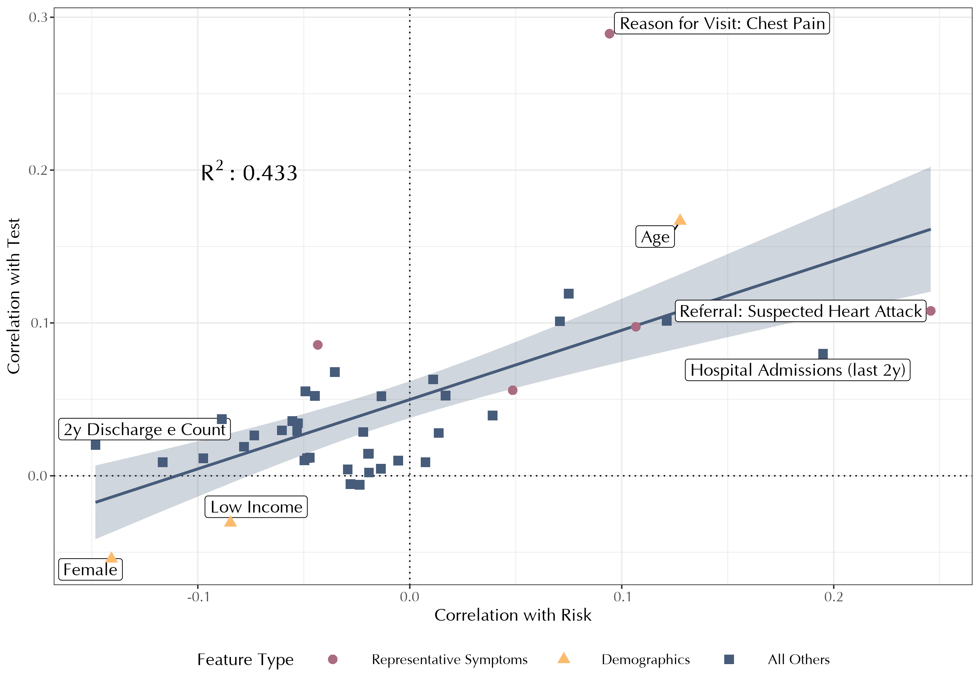
How well do physicians weight individual variables?
For each variable in the ‘simple’ model (k=49)
  Correlation with test decision vs. correlation with true risk
Symptom: Chest pain
Overall, weights correlate well
  R² = 0.433
But some notable outliers
Demographics: Age
Correlation with test decision
Demographics: Sex, Income
Correlation with true risk

Slide 22
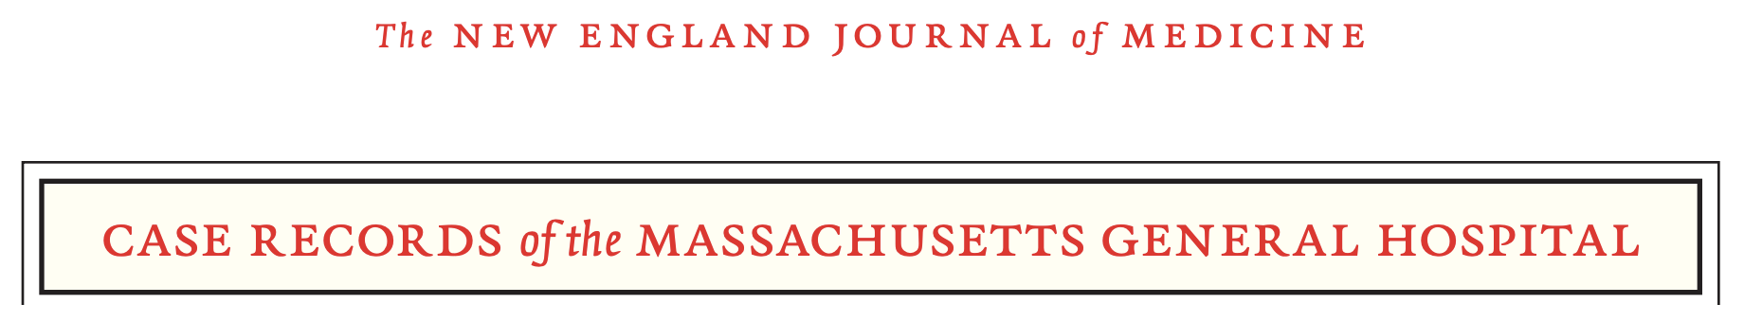
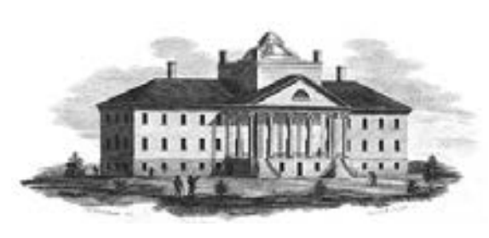
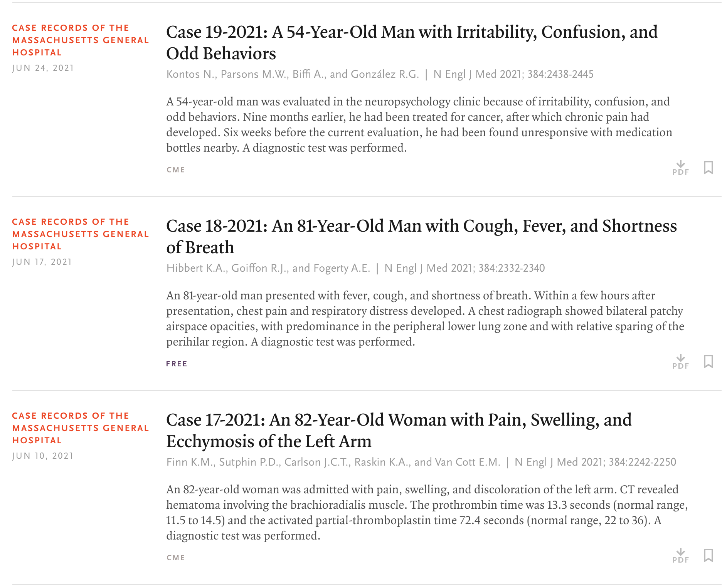
Some variables are more salient than others
Symptoms, demographics stand out
The first thing physicians see about patients
A key part of vignettes, medical education

Slide 23
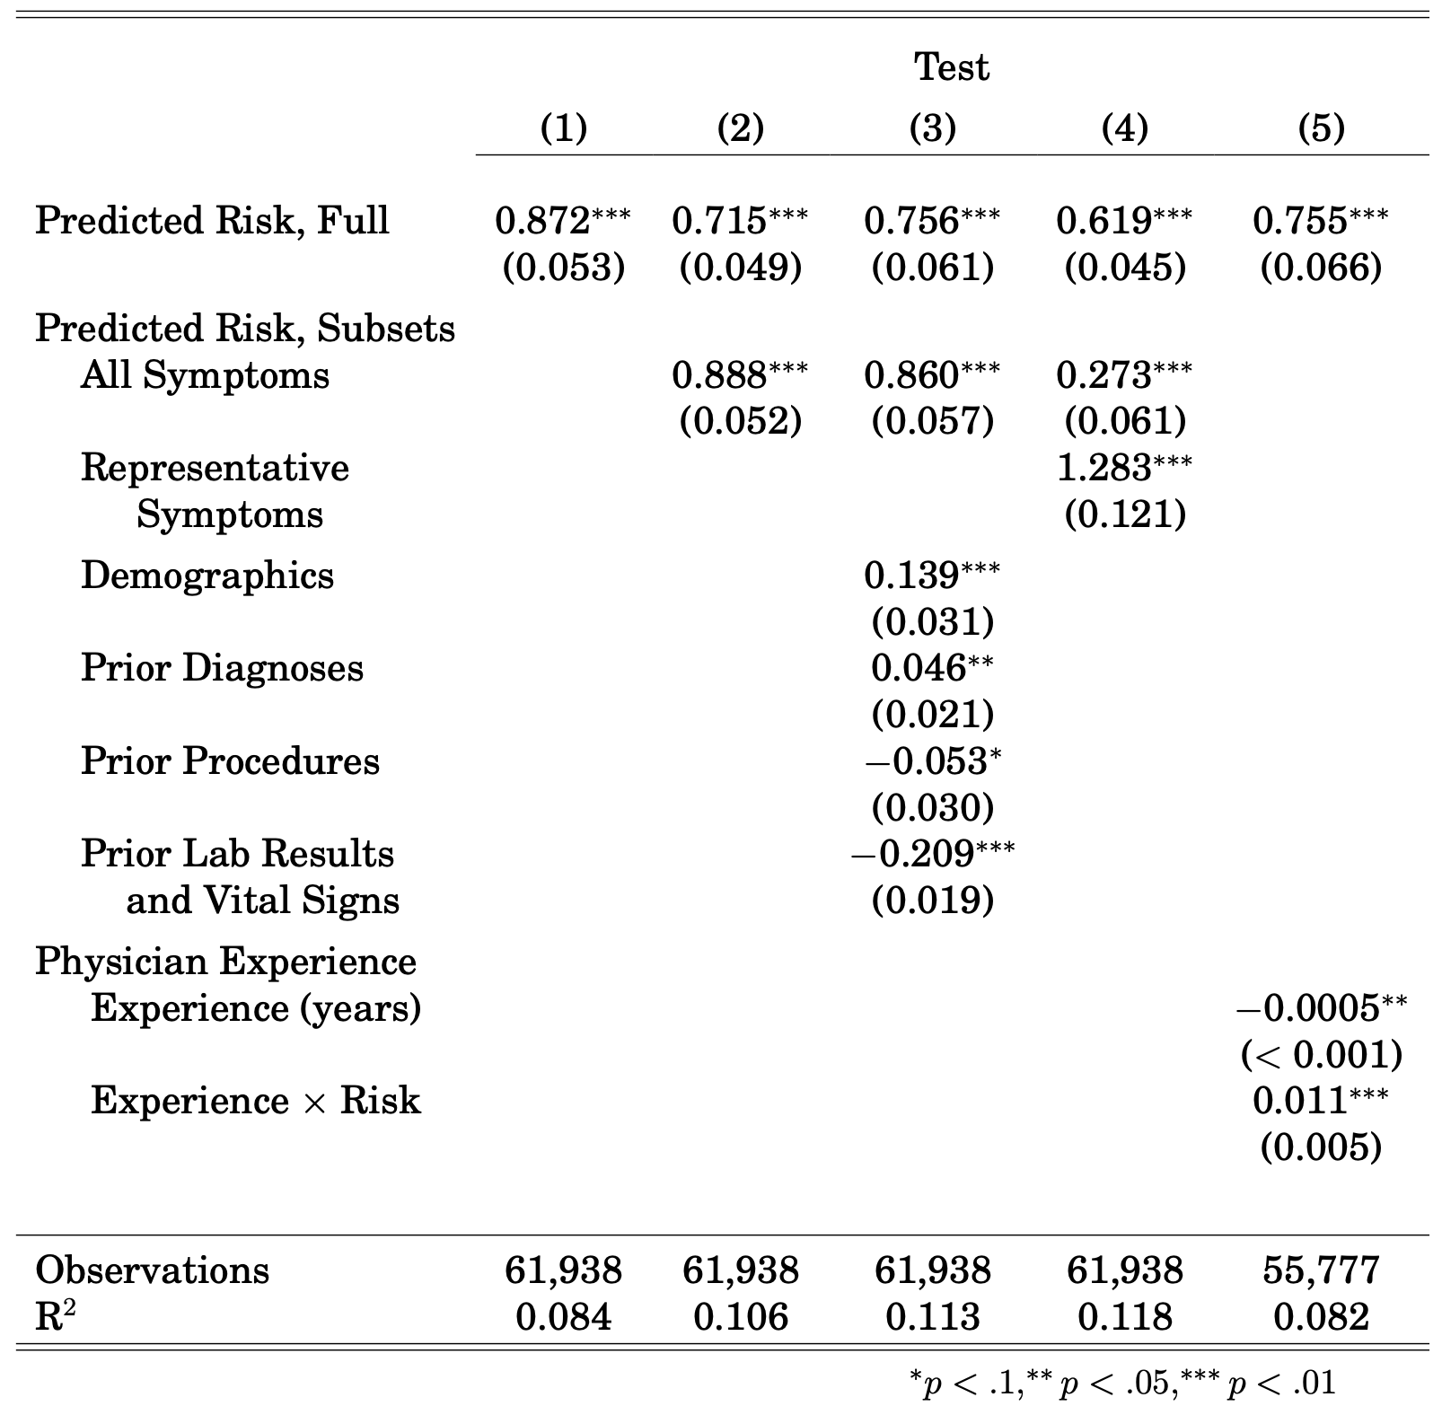
Physicians over-weight risk signals in salient categories
Form new risk scores with one input type
  e.g., symptoms
Do these predict test decision?
  Should not, conditioned on full risk score with all inputs

Slide 24
Summary
Mis-prediction is a driver of both over- and under-use
  Preferred estimate: keep 38% old tests… add 16% new
  Not so much how much testing, but who is tested
Many believe ML will transform health care
  Most focus on ML as a product
  e.g., hospital buys software to replace radiologists
ML is also a powerful new tool for understanding
  New inefficiencies, new models of physician behavior

